Slide 1
CS 547
JavaScript
Week 13 Day 2

Slide 2
Agenda
Administration
Pillow on mac
JavaScript
objects
functions
IDEs / debuggers
JSON

Slide 3
JS Language Basics
Syntax, Values, Operators, Expressions, Keywords, and Comments
Literals, Variables, Operators, and Key Words
Statements, Expressions and Semi colons
Variables
Numbers, Strings, Arrays, Objects
Objects
Functions
Notes:
But before we get into those, let’s look at some of the fundamentals of JS

Slide 4
Pillow on Mac

Slide 5
JS IDEs
Sublime Text 3 or 2 http://www.sublimetext.com/
Brackets from brakets.io http://brackets.io/
JetBrains WebStorm https://www.jetbrains.com/webstorm/
Netbeans https://netbeans.org/features/html5/ (with appropriate plugins)

Slide 6
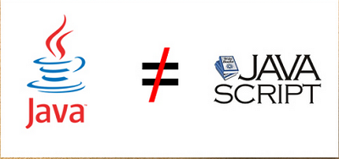
Reminder- JavaScript

Slide 7
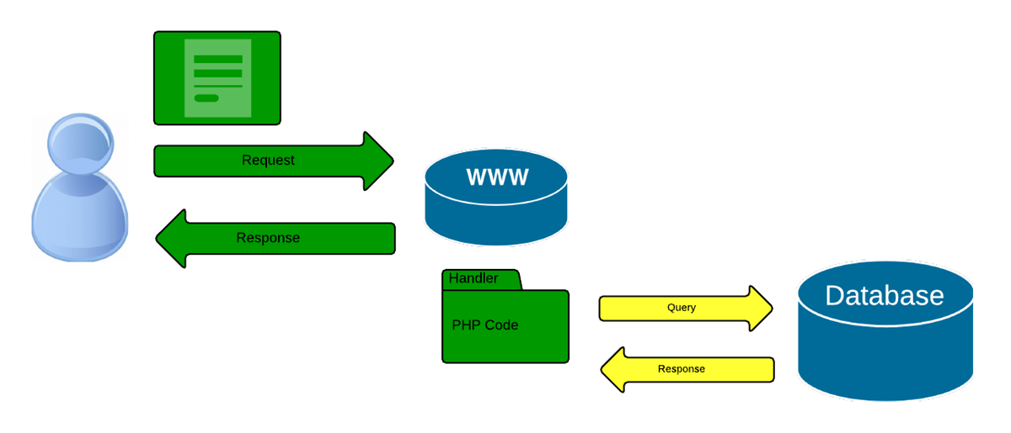
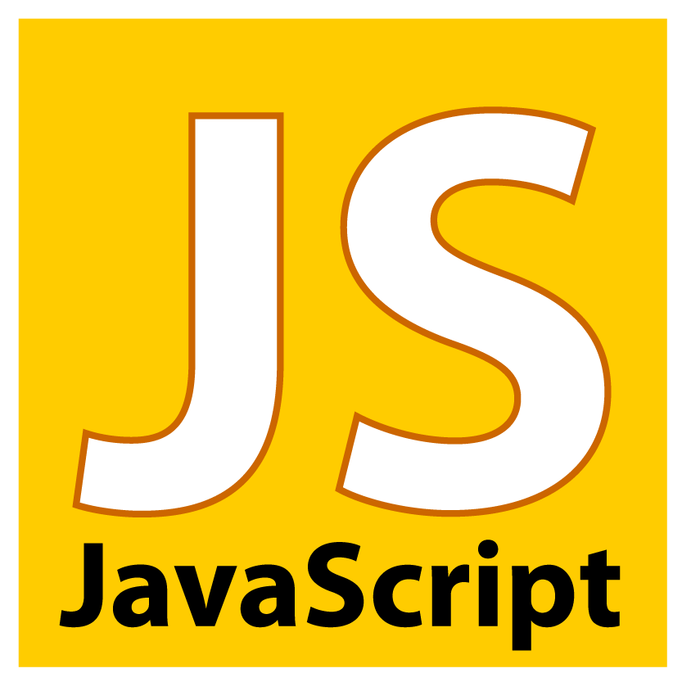
Reminder- JS:

Slide 8
Reminder- JS Object Orientated Nature
In JS an object is a dynamic collection of properties.
Every property has a key string that is unique within that object,
* An object in JS is not an instance of a class. *

Slide 9
JS Objects
Simple types – immutable
numbers, strings, booleans (true and false), null, and undefined
Everything else is an object – mutable keyed collections
arrays, functions, regular expressions, and, objects are objects
But recall that JS objects are not like they are in Java.

Slide 10
JS Objects
An Object is a container of Properties
Properties have a Name and a Value
“first_name” : “Freddie”
A property name can be any string, including the empty string. A property value can be any JavaScript value except for undefined.
“” : “something” ; “fname” : undefined;

Slide 11
JS Objects
Objects in JavaScript are class-free.
No constraint on the names of new properties or on the values of properties.
Objects are useful for collecting and organizing data.
Objects can contain other objects.
JavaScript includes a prototype linkage feature that allows one object to inherit the properties of another.
Notes:
When used well, prototypes can reduce object initialization time and memory consumption.

Slide 12
JS Objects Creation
to create an object use curly brackets
var empty_object = { }; //object literal
var rockStar= {
firstName : “Freddy”,
lastName : “Mercury”
}

Slide 13
JS Objects Retrieval
Retrieval: values can be retired in two ways: obj.[“string”] or obj.string
rockstar[“firstName”] // returns “Freddy”
rockstar.firstName; // returns “Freddy”
}

Slide 14
JS Objects Update
A value in an object can be updated by assignment. If the property name already exists in the object, the property value is replaced
rockstar[“firstName”] = “Frederick”;
If the object does not already have that property name, the object is augmented:
rockstar.realName = “Farrokh Bulsara”;
Notes:
No errors thrown!

Slide 15
JS Objects Reference
Objects are passed around by reference. They are never copied:
var a = {}, b = {}, c = {};
// a, b, and c each refer to a
// different empty object
a = b = c = {};
// a, b, and c all refer to
// the same empty object

Slide 16
JS Objects Prototype
Every object is linked to a prototype object from which it can inherit properties.
All objects created from object literals are linked to Object.prototype, an object that comes standard with JavaScript.

Slide 17
JS Objects Prototype
if (typeof Object.create !== 'function') {
Object.create = function (o) {
var F = function () {};
F.prototype = o;
return new F();
};
}
var another_rockStar = Object.create(rockStar);
The prototype link has no effect on updating. The prototype link is used only in retrieval. JS will look up the chain till it finds Object.prototype.This is called delegation, it is dynamic and if we add a new property to the prototype
Notes:
If we try to retrieve a property value from an object, and if the object lacks the property name, then JavaScript attempts to retrieve the property value from the prototype object. And if that object is lacking the property, then it goes to its prototype, and so on until the process finally bottoms out with Object.prototype. If the desired property exists nowhere in the prototype chain, then the result is the undefined value. T

Slide 18
JS Objects Prototype
Delegation is dynamic and if we add a new property to the prototype that property will immediately be visible in all of the objects that are based on that prototype:
rockStar.profession = ‘singer';
another_rockStar.profession // ‘singer'

Slide 19
JS Objects Reflection
Reflection is a way of inspecting an object to determine what properties it has by attempting to retrieve the properties and examining the values obtained. Two methods to use reflection:
typeof
typeof rockStar.firstName ; // string
hasOwnProperty
rockStar.hasOwnProperty(“profession”); // true

Slide 20
JS Objects Enumeration
You can use for loops to loop through all the properties in an object. There are two forms
for .. in
– this will loop through all the properties including function and prototype properties. Does not guarantee order
for (start; stop; increment)
– this will loop through all the properties in order without the function and prototype properties.

Slide 21
JS Objects Enumeration
for .. in – this will loop through all the properties including function and prototype properties. Does not guarantee order
var name;
for (name in another_rockStar) {
…
}

Slide 22
JS Objects Enumeration
for (start; stop; increment)– this will loop through all the properties in order without the function and prototype properties.
var i;
var properties = [ 'first_name', 'last_name', 'profession' ];
for (i = 0; i < properties.length; i += 1) {
document.writeln(properties[i] + ': ' + another_rockStar[properties[i]]); }

Slide 23
JS Objects Delete
The delete operator can be used to remove a property from an object. It will remove a property from the object if it has one.
It will not touch any of the objects in the prototype linkage.

Slide 24
JS Global Abatement
JavaScript makes it easy to define global variables that can hold all of the assets of your application.
Unfortunately, global variables weaken the resiliency of programs and
should be avoided.
Notes:
This is important!

Slide 25
JS Global Abatement
One way to minimize the use of global variables is to create a single global variable for your application:
var MYAPP = {};
That variable then becomes the container for your application:
MYAPP.rockStar = {
"first_name": “Taylor",
"last_name": “Swift"
};
Notes:
This is important!

Slide 26
JS Global Abatement
By reducing your global footprint to a single name, you significantly reduce the chance of bad interactions with other applications, widgets, or libraries.
Your program also becomes easier to read because it is obvious that
MYAPP.rockStar refers to a top-level structure.
Notes:
This is important!

Slide 27
JS Objects
Objects can also contain functions… so let’s talk about functions.

Slide 28
JS Functions
Functions are one of the best things about JavaScript.
Functions in JavaScript are objects.
Objects are collections of name/value pairs having a hidden link to a prototype object.
Objects produced from object literals are linked to Object.prototype.

Slide 29
JS Functions
Function objects are linked to Function.prototype (which is itself linked to Object.prototype).
Every function is also created with two additional hidden properties:
the function’s context and
the code that implements the function’s behavior.
Every function object is also created with a prototype property. Its value is an object with a constructor property whose value is the function.
This is distinct from the hidden link to Function.prototype.

Slide 30
JS Functions
Since functions are objects, they can be used like any other value.
Functions can be stored in variables, objects, and arrays.
Functions can be passed as arguments to functions, and functions can be returned from functions.
Also, since functions are objects, functions can have methods.
The thing that is special about functions is that they can be invoked.

Slide 31
Functions Literals
Function objects are created with function literals:
// Create a variable called add and store a function
// in it that adds two numbers.
var add = function (a, b) {
return a + b;
};

Slide 32
Functions Literals
Four parts to a function:
var add = function (a, b) {
return a + b;
};
Reserved word ‘function’
an optional function name – if there is no name it is called an anonymous function
set of optional parameters
the statements inside the { brackets}
Notes:
This is an anonymous function assigned to a variable add.

Slide 33
Functions closure
var add = function (a, b) {
return a + b;
};
A function literal can appear anywhere that an expression can appear.
Functions can be defined inside of other functions.
An inner function of course has access to its parameters and variables.
An inner function also enjoys access to the parameters and variables of the functions it is nested within. The function object created by a function literal contains a link to that outer context.
This is called closure. This is the source of enormous expressive power

Slide 34
Function Invocation
Invoking a function suspends the execution of the current function, passing control and parameters to the new function.
In addition to the declared parameters, every function receives two additional parameters:
this
arguments.
The this parameter is very important in object oriented programming, and its value is determined by the invocation pattern.
Notes:
This is a key to understanding how to write code in JS

Slide 35
Function Invocation
There are four patterns of invocation in JavaScript:
Method invocation
Function invocation
Constructor invocation
Apply invocation
The patterns differ in how the bonus parameter this is initialized.
Notes:
This is a key to understanding how to write code in JS

Slide 36
Function Invocation
The invocation operator is a pair of parentheses (b)that follow any expression that produces a function value.
The parentheses can contain zero or more expressions, separated by commas. Each expression produces one argument value. Each of the argument values will be assigned to the function’s parameter names.
There is no runtime error when the number of arguments and the number of parameters do not match. If there are too many argument values, the extra argument values will be ignored. If there are too few argument values, the undefined value will be substituted for the missing values.
There is no type checking on the argument values: any type of value can be passed to any parameter.
Notes:
This is a key to understanding how to write code in JS

Slide 37
Method Invocation Pattern
When a function is stored as a property of an object, we call it a method. When a method is invoked, this is bound to that object.
If an invocation expression contains a refinement (that is, a . dot expression or [subscript] expression), it is invoked as a method:
var myObject = {
value: 0,
increment: function (inc) {
this.value += typeof inc === 'number' ? inc : 1;
}
};
myObject.increment( );
document.writeln(myObject.value); // 1
myObject.increment(2);
document.writeln(myObject.value); // 3
Notes:
A method can use this to access the object so that it can retrieve values from the object or modify the object. The binding of this to the object happens at invocation time. This very late binding makes functions that use this highly reusable. Methods that get their object context from this are called public methods.

Slide 38
Function Invocation Pattern
When a function is not the property of an object, then it is invoked as a function:
var sum = add(3, 4); // sum is 7
When a function is invoked with this pattern, this is bound to the global object. This was a mistake in the design of the language. Had the language been designed correctly, when the inner function is invoked, this would still be bound to the this variable of the outer function.
A consequence of this error is that a method cannot employ an inner function to help it do its work because the inner function does not share the method’s access to the object as its this is bound to the wrong value.
Notes:
This is a key to understanding how to write code in JS

Slide 39
Function Invocation Pattern
Fortunately, there is an easy workaround. If the method defines a variable and assigns it the value of this, the inner function will have access to this through that variable. By convention, the name of that variable is that:
// Augment myObject with a double method.
myObject.double = function ( ) {
var that = this; // Workaround.
var helper = function ( ) {
that.value = add(that.value, that.value);
};
helper( ); // Invoke helper as a function.
};
// Invoke double as a method.
myObject.double( );
document.writeln(myObject.getValue( )); // 6
Notes:
This is a key to understanding how to write code in JS

Slide 40
Constructor Invocation Pattern
JavaScript is a prototypal inheritance language. That means that objects can inherit properties directly from other objects. The language is class-free.
This is a radical departure from the current fashion. Most languages today are classical. Prototypal inheritance is powerfully expressive, but is not widely understood.
Notes:
This is a key to understanding how to write code in JS

Slide 41
Constructor Invocation Pattern
If a function is invoked with the new prefix, then a new object will be created with a hidden link to the value of the function’s prototype member, and this will be bound to that new object.
The new prefix also changes the behavior of the return statement.
Notes:
This is a key to understanding how to write code in JS

Slide 42
Constructor Invocation Pattern
// Create a constructor function called Quo.
// It makes an object with a status property.
var Quo = function (string) {
this.status = string;
};
// Give all instances of Quo a public
// called get_status.
Quo.prototype.get_status = function ( ) {
return this.status;
};
// Make an instance of Quo.
var myQuo = new Quo("confused");
document.writeln(myQuo.get_status( )); // writes confused
Notes:
Functions that are intended to be used with the new prefix are called constructors. By convention, they are kept in variables with a capitalized name. If a constructor is called without the new prefix, very bad things can happen without a compile-time or runtime warning, so the capitalization convention is really important. Use of this style of constructor functions is not recommended. We will see better alternatives in the next chapter.

Slide 43
Apply Invocation Pattern
Because JavaScript is a functional object-oriented language, functions can have methods.
The apply method lets us construct an array of arguments to use to invoke a function. It also lets us choose the value of this.
The apply method takes two parameters. The first is the value that should be bound to this. The second is an array of parameters.

Slide 44
Apply Invocation Pattern
// Make an array of 2 numbers and add them.
var array = [3, 4];
var sum = add.apply(null, array); // sum is 7
// Make an object with a status member.
var statusObject = {
status: 'A-OK'
};
// statusObject does not inherit from Quo.prototype,
// but we can invoke the get_status method on
// statusObject even though statusObject does not have
// a get_status method.
var status = Quo.prototype.get_status.apply(statusObject);
// status is 'A-OK'

Slide 45
Apply Invocation Pattern
// Make an array of 2 numbers and add them.
var array = [3, 4];
var sum = add.apply(null, array); // sum is 7
// Make an object with a status member.
var statusObject = {
status: 'A-OK'
};
// statusObject does not inherit from Quo.prototype,
// but we can invoke the get_status method on
// statusObject even though statusObject does not have
// a get_status method.
var status = Quo.prototype.get_status.apply(statusObject);
// status is 'A-OK'

Slide 46
Function Arguments
A bonus parameter that is available to functions when they are invoked is the arguments array. It gives the function access to all of the arguments that were supplied with the invocation, including excess arguments that were not assigned to parameters.
This makes it possible to write functions that take an unspecified number of parameters.

Slide 47
Function Arguments
// Make a function that adds a lot of stuff.
var sum = function ( ) {
var i, sum = 0;
for (i = 0; i < arguments.length; i += 1) {
sum += arguments[i];
}
return sum;
};
document.writeln(sum(4, 8, 15, 16, 23, 42)); // 108
Notes:
// Note that defining the variable sum inside of
// the function does not interfere with the sum
// defined outside of the function. The function
// only sees the inner one.

Slide 48
Return
When a function is invoked, it begins execution with the first statement, and ends
when it hits the } that closes the function body. That causes the function to return
control to the part of the program that invoked the function.
The return statement can be used to cause the function to return early. When return is executed, the function returns immediately without executing the remaining statements.
A function always returns a value. If the return value is not specified, then undefined is returned.
If the function was invoked with the new prefix and the return value is not an object, then this (the new object) is returned instead.

Slide 49
Recursion
A recursive function is a function that calls itself, either directly or indirectly.
Recursive functions can be very effective in manipulating tree structures such as the browser’s Document Object Model (DOM). Each recursive call is given a smaller piece of the tree to work on:

Slide 50
Scope
Scope in a programming language controls the visibility and lifetimes of variables and parameters.
Most languages with C syntax have block scope. All variables defined in a block (a list of statements wrapped with curly braces) are not visible from outside of the block. The variables defined in a block can be released when execution of the block is finished. This is a good thing.
Unfortunately, JavaScript does not have block scope even though its block syntax suggests that it does.
This confusion can be a source of errors.

Slide 51
Scope
JavaScript does have function scope. That means that the parameters and variables defined in a function are not visible outside of the function, and that a variable defined anywhere within a function is visible everywhere within the function.
In many modern languages, it is recommended that variables be declared as late as possible, at the first point of use. That turns out to be bad advice for JavaScript because it lacks block scope.
So instead, it is best to declare all of the variables used in a function at the top of the function body.

Slide 52
Closure
The good news about scope is that inner functions get access to the parameters and variables of the functions they are defined within (with the exception of this and arguments). This is a very good thing.
A more interesting case is when the inner function has a longer lifetime than its outer function.
More on this in a bit

Slide 53
Callbacks
Callback are a powerful feature of JavaScript. Functions can make it easier to deal with discontinuous events. For example, suppose there is a sequence that begins with a user interaction, making a request of the server, and finally displaying the server’s response.

Slide 54
Callbacks
The naïve way to write that would be:
request = prepare_the_request( );
response = send_request_synchronously(request);
display(response);
The problem with this approach is that a synchronous request over the network will leave the client in a frozen state. If either the network or the server is slow, the degradation in responsiveness will be unacceptable.

Slide 55
Callbacks
A better approach is to make an asynchronous request, providing a callback function that will be invoked when the server’s response is received. An asynchronous function returns immediately, so the client isn’t blocked:
request = prepare_the_request( );
send_request_asynchronously(request, function (response) {
display(response);
});
We pass a function parameter (display) to the send_request_asynchronously function that will be called when the response is available.

Slide 56
Modules
In JS we can use functions and closure to make modules.
A module is a function or object that presents an interface but that hides its state and implementation.
By using functions to produce modules, we can almost completely eliminate our use of global variables, thereby mitigating one of JavaScript’s worst features.
Many of the popular ‘libraries’ are indeed modules.
Notes:
Unlike php and python there is no reserved module keyword or file dir structure.

Slide 57
Cascade Functions
In JS some methods do not have a return value. For example, it is typical for methods that set or change the state of an object to return nothing.
If we have those methods return this instead of undefined, we can enable cascades.
In a cascade, we can call many methods on the same object in sequence in a single statement.
Notes:
Cascades are fun

Slide 58
Cascade Functions
Cascades allow us to write in a style like this:
getElement('myBoxDiv').move(350, 150).width(100).height(100).color('red').
border('10px outset').padding('4px').appendText("Please stand by").
on('mousedown', function (m) {
this.startDrag(m, this.getNinth(m));
}).
on('mousemove', 'drag').
on('mouseup', 'stopDrag').
later(2000, function ( ) {
this.color('yellow').
setHTML("What hath God wraught?").
slide(400, 40, 200, 200);
}).tip('This box is resizeable');
Notes:
Cascades are fun

Slide 59
Curry Functions
Functions are values, and we can manipulate function values in interesting ways.
Currying allows us to produce a new function by combining a function and an
argument:
var add1 = add.curry(1);
document.writeln(add1(6)); // 7
Notes:
Cascades are fun

Slide 60
Curry Functions
JavaScript does not have a curry method, but we can fix that by augmenting Function.prototype:
Function.method('curry', function ( ) {
var slice = Array.prototype.slice,
args = slice.apply(arguments),
that = this;
return function ( ) {
return that.apply(null, args.concat(slice.apply(arguments)));
};
});
Notes:
Cascades are fun

Slide 61
Memoization Functions
Functions can use objects to remember the results of previous operations, making it possible to avoid unnecessary work.
This optimization is called memoization. JavaScript’s objects and arrays are very convenient for this.
Notes:
Cascades are fun

Slide 62
Memoization Functions
The memoizer function will take an initial memo array and the fundamental function.
It returns a shell function that manages the memo store and that calls thebfundamental function as needed. We pass the shell function and the function’s
parameters to the fundamental function:
var memoizer = function (memo, fundamental) {
var shell = function (n) {
var result = memo[n];
if (typeof result !== 'number') {
result = fundamental(shell, n);
memo[n] = result;
}
return result;
};
return shell;
};
Notes:
Cascades are fun

Slide 63
Memoization Functions
By devising functions that produce other functions, we can significantly reduce the amount of work we have to do. For example, to produce a memoizing factorial function,we only need to supply the basic factorial formula:
var factorial = memoizer([1, 1], function (shell, n) {
return n * shell(n - 1);
});
Notes:
Cascades are fun

Slide 64
Function Summary
Functions in JavaScript are objects.
Functions can be stored in variables, objects, and arrays.
Functions can be passed as arguments to functions, and functions can be returned from functions.
Also, since functions are objects, functions can have methods.

Slide 65
Function Summary
There are four patterns of invocation in JavaScript:
Method invocation
Function invocation
Constructor invocation
Apply invocation
Functions can be Cascaded, use Closures, be turned ins Asynchronous Callback, and be Curried.

Slide 66
JSON
JSON JavaScript Object Notation is a very popular data interchange format.
It was developed by Douglas Crockford.
JSON is text-based, lightweight, and a human-readable format for data exchange between clients and servers.
JSON is derived from JavaScript and bears a close resemblance to JavaScript objects, but it is not dependent on JavaScript.
JSON is language-independent, and support for the JSON data format is available in all the popular languages, some of which are C#, PHP, Java, C++, Python, and Ruby.
JSON is a format and not a language!

Slide 67
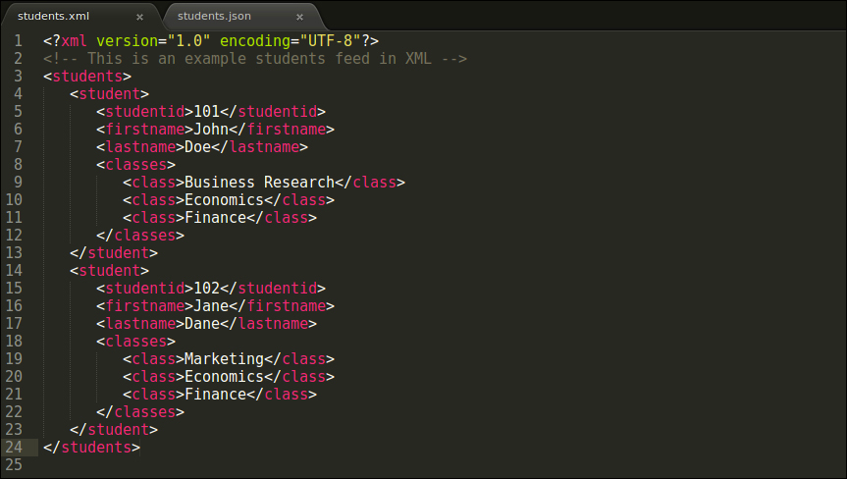
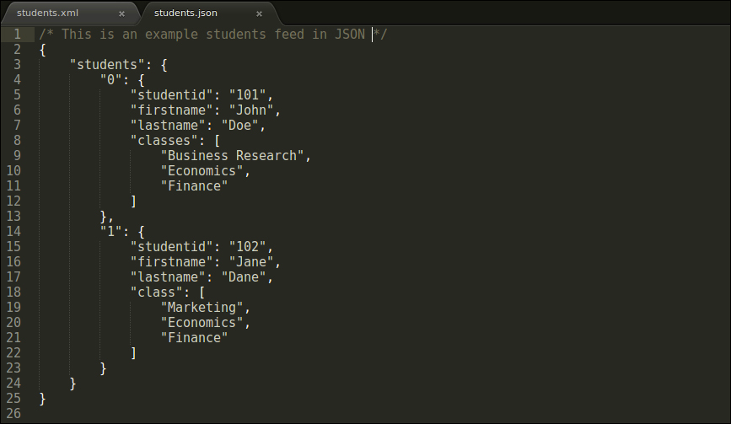
JSON vs XML

Slide 68
JSON
JSON is used by web applications to transfer data.
Prior to JSON, many application used XLM to exchange data.
Over the weekend read up on JSON at json.org

Slide 69
End of Slides
For next time
introduction to JS libraries
jQuery
Assignment 3

